Slide 1
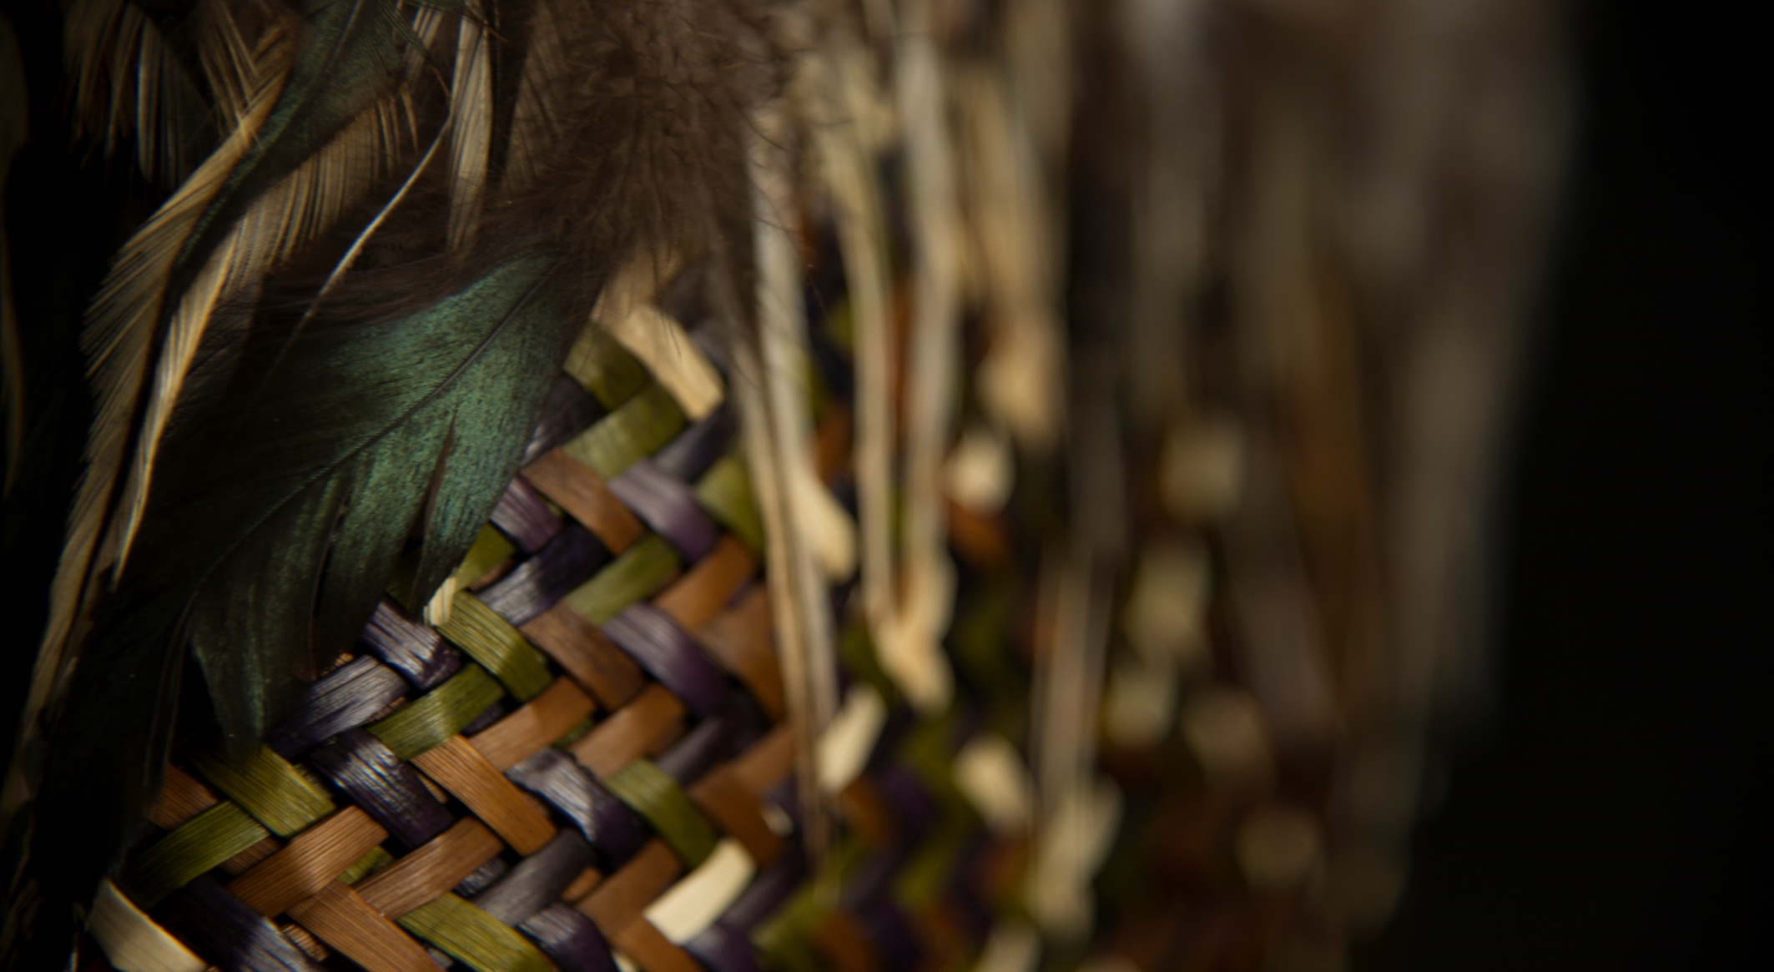

Te Rūnanga o Te Rarawa
3 October 2026
Special General Meeting

Slide 2
Background
  Te Rūnanga o Te Rarawa (the Rūnanga) is the Mandated Iwi Organisation (MIO) for Te Rarawa pursuant to the Māori Fisheries Act (MFA)
  The MFA has been amended by the Māori Fisheries Amendment Act 2024 (the MFAA)
  The MFAA was passed into law in 2024, but parts of it did not come into force until 2026 – this was the statutory deadline that all MIOs had to be compliant by. This deadline was 26 July 2026
  Te Ohu Kaimoana have confirmed a 6 month grace period as many MIOs were not compliant by the statutory deadline
  The MFAA introduced a number of legislative changes, some of which relate to the governing entities of MIO’s and asset-holding companies
  The Rūnanga is required to go through its ordinary amendment processes, even though the changes are required by legislation.

Slide 3
Te Rūnanga o Te Rarawa Trustee Limited
Te Rūnanga o Te Rarawa
Te Waka Pupuri Group
14.29%
20%
100%
Te Waka Pupuri Putea Trust
Te Rarawa Anga Mua Trust
Amokura Iwi Consortium Limited
Hinemoana Halo Partnership Fund Limited
Te Waka Pupuri Putea Limited
1.77%
0.61%
100%
100%
100%
100%
100%
Aotearoa Fisheries Limited
Northland milk New Zealand Limited
Te Rarawa ICP Partners Limited
Bells Produce Limited
Kapene Te Rarawa Limited
Tupu-Ā-Nuku Limited
KPH Construction Limited
ICP Inshore ACE Limited Partnership
ICP ACE Holdings Limited Partnership
5.26%
100%
100%
100%
100%
ICP General Partner Limited
Mahuru Trust Limited
Te Rarawa Farming Limited
Te Rarawa Plumbing Limited
TRTKK Limited
ICP Koura Facilities LP
ICP Koura Operations LP
Being removed
50%
93.33%
33.78%
Taitokerau Investment Fund Limited Partnership
Taitokerau Investment Fund General Partner Limited
Te Whainga Putea Limited
Taitokerau Fibre Networks Limited
Key
= Trust
= Wholly-owned company
= Partially owned company
= Limited Partnership
= Te Waka Pupuri Putea Group
2.31%
50%
Delta Produce Co-operative Limited
Sweetwater Farms Limited Partnership
Sweetwater Farms General Partner Limited

Slide 4
Parameters
The Rūnanga has taken an approach that will ensure compliance by:
  Adopting amendments to ensure the Trust Deed is compliant with the MFAA within the ‘grace period’
  Allowing for further discussion and consultation on other amendments which are possible (but not required under the MFAA), these are more substantive in nature and can be amended at any time in the future, now that the MFAA is in place.
  Other legislative updates (i.e. the Trustees Act has been replaced with the Trusts Act 2019).

Slide 5
Summary of MFAA amendments
These are technical in nature, and include:
  AFL shares are now held directly – these transferred on 26 July, to all asset-holding companies
  Because shares will be held directly, the Rūnanga will need to represent Te Rarawa by speaking and voting at shareholder meetings.
  The removal of references to legislative requirements that will no longer exist in the MFA
  Te Kawai Taumata has been disestablished, and the Rūnanga will now participate in the Te Tai Tokerau Electoral College process – this is provided for in the drafting
  A requirement to report on interactions with AFL is now required, so Annual Report processes have been updated to include this
  There have been amendments to the strategic governance clauses, making it clear that the Rūnanga must exercise strategic governance over its asset holding company (Te Waka Pupuri Pūtea Limited), and its wholly owned subsidiaries

Slide 6
Summary of MFAA amendments
The MFAA allows the Rūnanga to amend its deed, for more substantive changes, for example:
  There is no longer a requirement for a Special Resolution to dispose (or use in other scenarios) Settlement Quota and Income Shares, rather the MFAA allows the MIO to provide for its own approval processes – the Rūnanga has retained the Special Resolution requirement for now, until there has been further discussion with iwi members. There are a range of other ‘approval’ processes, Te Rarawa may want to consider
  The ‘40% governance limitation’ has been removed, previously you could not have more than a 40% overlap between the MIO and AHC, this is no longer. This has been retained, for now but may be removed in the future.
  The MFAA now expressly allows for election models whereby iwi members vote for example, on a marae or hapū basis. This is already the case for Te Rarawa, but the clarification is useful.

Slide 7
Process to amend
In order for the amendments to be approved, they must be approved by a ‘Special Resolution’ of iwi members at a General Meeting.
If successful, a Deed of Amendment will then need to be prepared and executed.
Note: Te Ohu Kaimoana has ‘pre-approved’ the amendments, formal approval will be sought but we do not expect any issues given the pre-approval.

Slide 8
Pātai

